Slide 1
Big Data Analysis and Mining
Cluster Analysis
Qinpei Zhao 赵钦佩
qinpeizhao@tongji.edu.cn

Slide 2
Outline
Cluster Basics
Clustering algorithms
Hierarchical clustering, spectral clustering
k-means, Expectation-Maximization (EM)
DBSCAN
state-of-art algorithms
Cluster Validity
determining the number of clusters
clustering evaluation
Notes:
2

Slide 3
Partitioning Algorithms
Partitioning method: Construct a partition of n data into a set of K clusters
Given: a set of data and the number K
Find: a partition of K clusters that optimizes the chosen partitioning criterion
Globally optimal
Intractable for many objective functions
Ergo, exhaustively enumerate all partitions
Effective heuristic methods: K-means and K-medoids algorithms

Slide 4
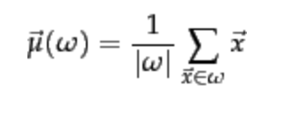
K-Means
Assumes data points are real-valued vectors.
Clusters based on centroids (aka the center of gravity or mean) of points in a cluster, c:
Reassignment of instances to clusters is based on distance to the current cluster centroids.
(Or one can equivalently phrase it in terms of similarities)

Slide 5

K-Means Algorithm
Select K random data {c₁, c₂ ,… c_{K}} from data {x₁, x₂ ,… x_{N}} as seeds.
Until clustering converges (or other stopping criterion):
//partitioning
For each point x_{i}:
Assign x_{i} to the cluster c_{j} such that dist(x_{i}, c_{j}) is minimal.
//Next, update the centroid of each cluster
For each cluster c_{j}
c_{j} = μ(c_{j})

Slide 6
K Means Example (K=2)
Pick seeds
Reassign clusters
Compute centroids
Reassign clusters
x
x
x
Compute centroids
x
x
x
Reassign clusters
Converged!

Slide 7
Example
10
10
9
9
8
8
7
7
6
6
5
5
4
Assign each objects to most similar center
Update the cluster means
4
3
3
2
2
1
1
0
0
0
1
2
3
4
5
6
7
8
9
10
0
1
2
3
4
5
6
7
8
9
10
reassign
reassign
K=2
Arbitrarily choose K object as initial cluster center
Update the cluster means

Slide 8
Termination conditions
Several possibilities, e.g.,
A fixed number of iterations.
data partition unchanged.
Centroid positions don’t change.
Does this mean that the data in a cluster are unchanged?

Slide 9
Convergence
Why should the K-means algorithm ever reach a fixed point?
A state in which clusters don’t change.
K-means is a special case of a general procedure known as the Expectation Maximization (EM) algorithm.
EM is known to converge.
Number of iterations could be large.
But in practice usually isn’t

Slide 10
Time Complexity
Computing distance between two data points is O(D) where D is the dimensionality of the vectors.
Reassigning clusters: O(KN) distance computations, or O(KND).
Computing centroids: Each point gets added once to some centroid: O(ND).
Assume these two steps are each done once for I iterations: O(IKND).

Slide 11
Strengths of K-means clustering
Relatively scalable in processing large data sets
Relatively efficient: O(tkn), where n is # objects, k is # clusters, and t is # iterations. Normally, k, t << n.
Often terminates at a local optimum; the global optimum may be found using techniques such as genetic algorithms

Slide 12
Weaknesses of K-means clustering
Applicable only when the mean of objects is defined
Need to specify k, the number of clusters, in advance
Unable to handle noisy data and outliers
Not suitable to discover clusters with non-convex shapes, or clusters of very different size

Slide 13
Outline
Cluster Basics
Clustering algorithms
Hierarchical clustering, spectral clustering
k-means, Expectation-Maximization (EM)
DBSCAN
state-of-art algorithms
Cluster Validity
determining the number of clusters
clustering evaluation
Notes:
13

Slide 14
Model based clustering
Algorithm optimizes a probabilistic model criterion
Clustering is usually done by the Expectation Maximization (EM) algorithm
Gives a soft variant of the K-means algorithm
Assume k clusters: {c₁, c₂,… c_{k}}
Assume a probabilistic model of categories that allows computing P(c_{i} | E) for each category, c_{i}, for a given example, E.
Parameters θ = {P(c_{i}), P(w_{j} | c_{i}): i∈{1,…k}, j∈{1,…,|V|}}

Slide 15
Expectation Maximization (EM) Algorithm
Iterative method for learning probabilistic categorization model from unsupervised data.
Initially assume random assignment of examples to categories.
Learn an initial probabilistic model by estimating model parameters θ from this randomly labeled data.
Iterate following two steps until convergence:
Expectation (E-step): Compute P(c_{i} | E) for each example given the current model, and probabilistically re-label the examples based on these posterior probability estimates.
Maximization (M-step): Re-estimate the model parameters, θ, from the probabilistically re-labeled data.

Slide 16
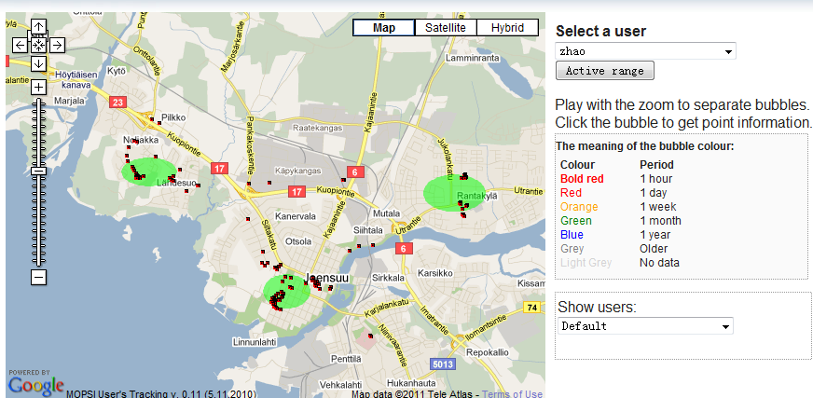
My activity area
A solution with model selection (determining the number of clusters) could be tested.

Slide 17
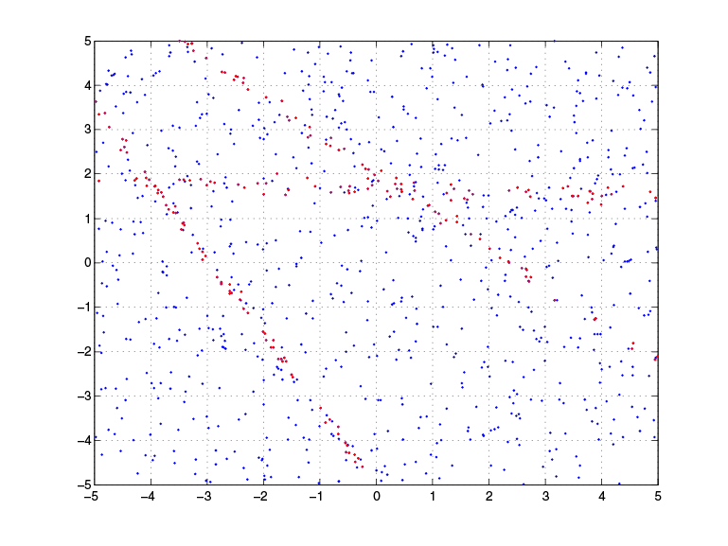
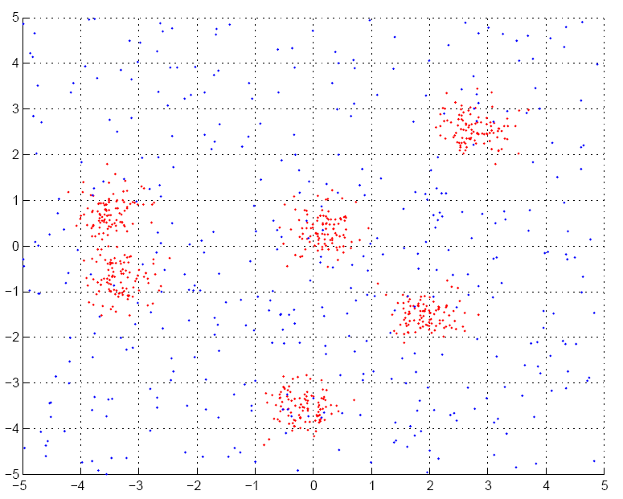
Applications of EM (1)
Fitting mixture models

Slide 18
Applications of EM (2)
Probabilistic Latent Semantic Analysis (pLSA)
Technique from text community
P(w,d)
P(w|z)
P(z|d)
Z
W
W
D
D
Z

Slide 19
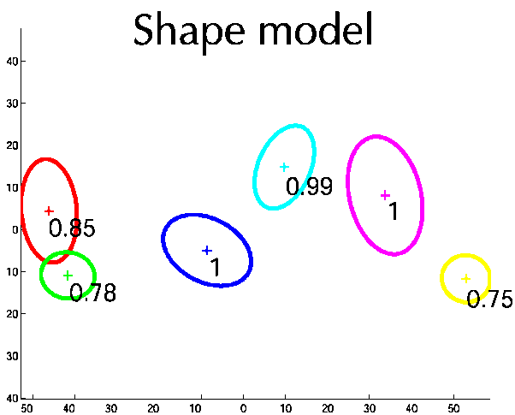
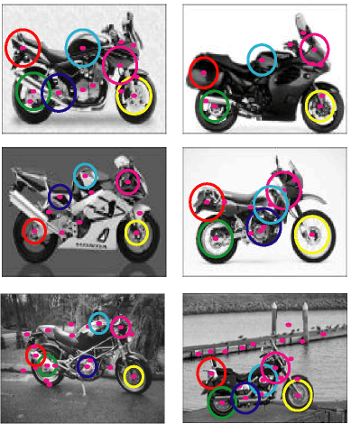
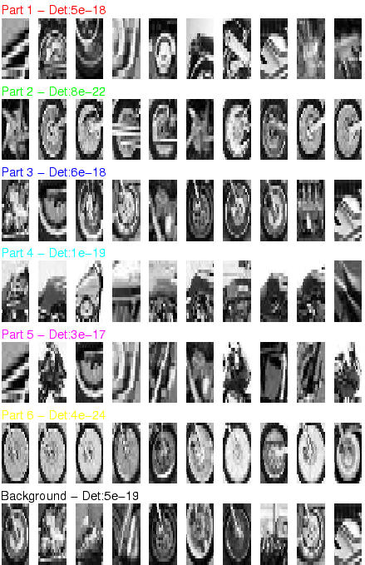
Applications of EM (3)
Learning parts and structure models

Slide 20
Meta-Idea
Probability
Model
Data
Inference
(Likelihood)
A model of the data generating process gives rise to data.
Model estimation from data is most commonly through Likelihood estimation

Slide 21
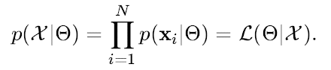
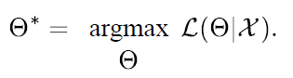
Likelihood Function
Likelihood Function
Find the “best” model which has generated the data. In a likelihood function
the data is considered fixed and one searches for the best model over the
different choices available.

Slide 22
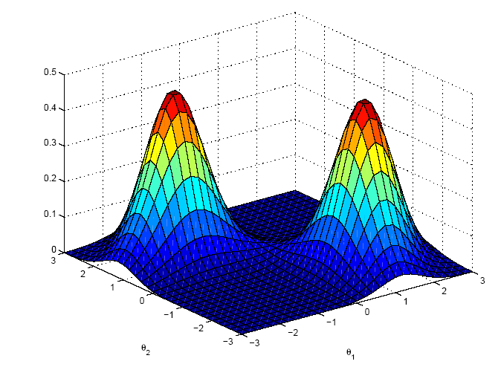
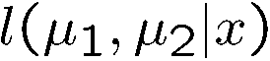
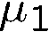
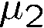
Likelihood function
Likelihood is a function of parameters, θ Probability is a function of r.v. x

Slide 23
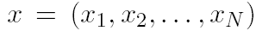
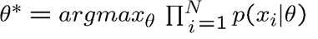
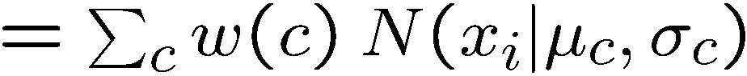
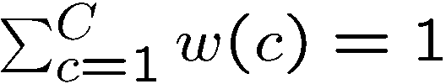
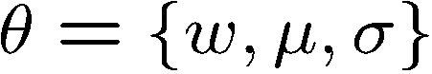
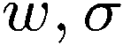

Motivating example
Data:
-4
-3
-2
-1
0
1
2
3
4
5
OBJECTIVE: Fit mixture of Gaussian model with C=2 components
Model:
where
Parameters:
P(x|θ)
keep
fixed
i.e. only estimate
x

Slide 24
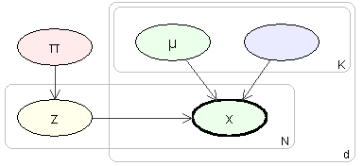
Probabilistic model
Imagine model generating data
Need to introduce label, z, for each data point
Label is called a latent variable
also called hidden, unobserved, missing
σ
c
-4
-3
-2
-1
0
1
2
3
4
5
Simplifies the problem:
if we knew the labels, we can decouple the components as estimate parameters separately for each one

Slide 25
Intuition of EM
E-step: Compute a distribution on the labels of the points, using current parameters
M-step: Update parameters using current guess of label distribution.
E
M
E
M
E

Slide 26
Theory

Slide 27
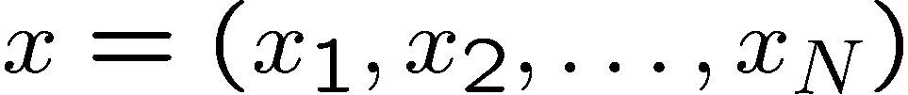
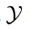

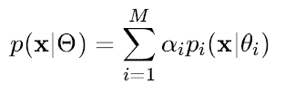
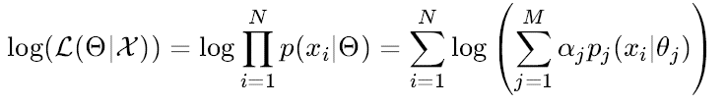
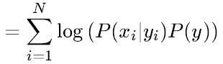
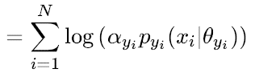
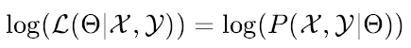
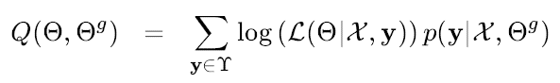
Some definitions
Observed data
Continuous I.I.D
Latent variables
Iteration index
Probabilistic model:
Log-likelihood [Incomplete log-likelihood (ILL)]
Complete log-likelihood (CLL)
Q function

Slide 28
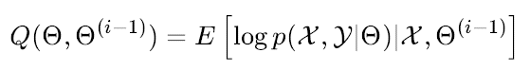
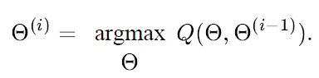
EM Algorithm
The EM Algorithm alternates the E-step and the M-step. Each iteration is guaranteed to increase the log-likelihood and the algorithm. The algorithm is guaranteed to converge to a local maximum of likelihood function.
E-Step
M-Step

Slide 29
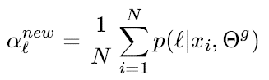
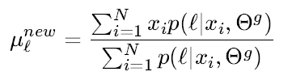
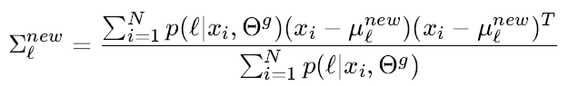
Estimates of the new parameters
The equations perform both the expectation step and the maximization step simultaneously.
Reference: Jeff A. Bilmes, “A Gentle Tutorial of the EM Algorithm and its Application to Parameter Estimation for Gaussian Mixture and Hidden Markov Models”, 1998.

Slide 30
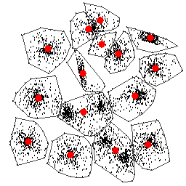
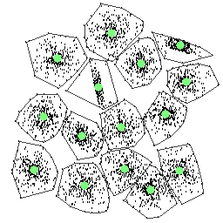
Kmeans V.S. EM
Local optimal
k-means:
Preferred input data structure: spherical (MSE)
Parameter: the number of clusters
Output cluster structure: centroid, partition
Initialization -> local optimal
Optimal

Slide 31



1140km
2160m
1864m
HuangShan Mountain
HuaShan Mountain
Notes:
An illustration on the local optimal problem of EM algorithm.
HuangShan Mountain is in the same province as where the conference holds and HuaShan Mountain is 1140 km away from HuangShan moutain.
Considering maximization estimation problem as climbing mountain to find the highest mountain in China. With a starting point in HuangShan, we can reach the highest point of Huangshan (1864m), which could be considered as a local optimal in EM algorithm. However, there is a higher point (2160m) in HuaShan Mountain, which is 1140 km away. If there is a hand of god (random swap) put you at somewhere in HuaShan mountain, then it’s easily to get the higher point (better local optimal) on HuaShan mountain.
31

Slide 32
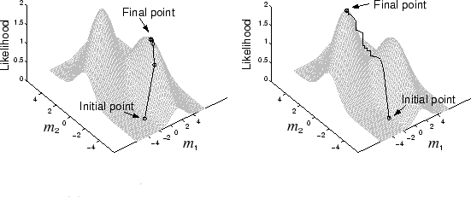
Local Optimal

Slide 33
Comparison

Slide 34
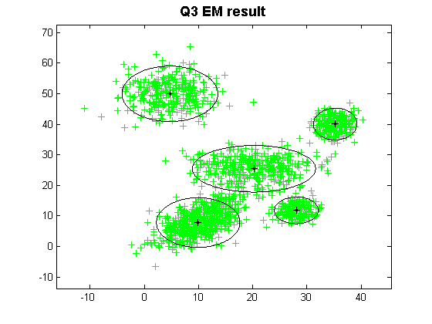
Kmeans V.S. EM
EM (Expectation-Maximization):
Preferred input data structure: Gaussian
Parameter: the number of clusters
Output cluster structure: model parameter
Initialization -> local optimal

Slide 35
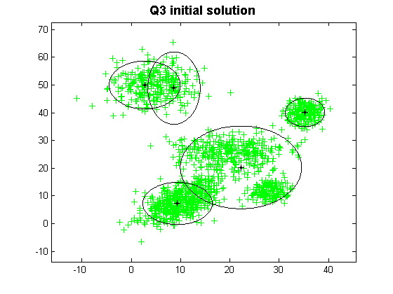

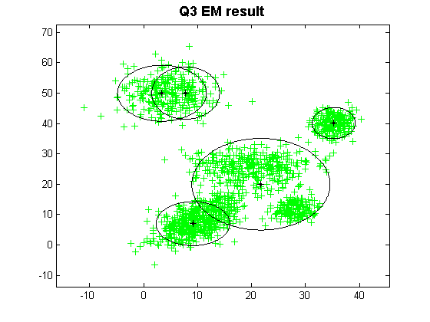
Initialization Effect in EM
Initialization and Result(1)
Initialization and Result(2)

Slide 36
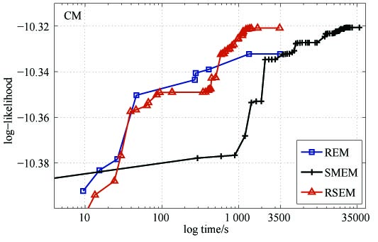
Comparisons
Data set: CM
Methods: REM, SMEM, RSEM

Slide 37
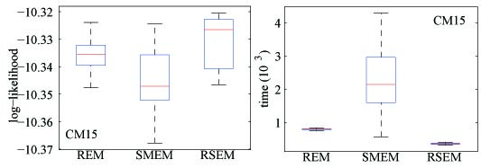
Comparisons
Data set: CM with K = 15
Methods: REM, SMEM, RSEM
50 repetitions

Slide 38
Outline
Cluster Basics
Clustering algorithms
Hierarchical clustering, spectral clustering
k-means, Expectation-Maximization (EM)
DBSCAN
state-of-art algorithms
Cluster Validity
determining the number of clusters
clustering evaluation
Notes:
38

Slide 39
Density based clustering
Why Density-Based Clustering methods?
Discover clusters of arbitrary shape.
Clusters – Dense regions of objects separated by regions of low density
DBSCAN – the first density based clustering
OPTICS – density based cluster-ordering

Slide 40
DBSCAN: Density Based Spatial Clustering of Applications with Noise
Proposed by Ester, Kriegel, Sander, and Xu (KDD96)
Relies on a density-based notion of cluster: A cluster is defined as a maximal set of density-connected points.
Discovers clusters of arbitrary shape in spatial databases with noise

Slide 41
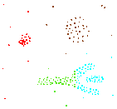
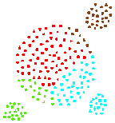
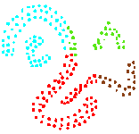
Density-based clustering
Basic Idea:
Clusters are dense regions in the data space, separated by regions of lower object density
Why Density-Based Clustering?
Results of a k-medoid algorithm for k=4
Different density-based approaches exist (see Textbook & Papers) Here we discuss the ideas underlying the DBSCAN algorithm

Slide 42
Density Based Clustering: Basic Concept
Intuition for the formalization of the basic idea
For any point in a cluster, the local point density around that point has to exceed some threshold
The set of points from one cluster is spatially connected
Local point density at a point p defined by two parameters
ε – radius for the neighborhood of point p: N_{ε} (p) := {q in data set D | dist(p, q) ≤ ε}
MinPts – minimum number of points in the given neighbourhood N(p)

Slide 43
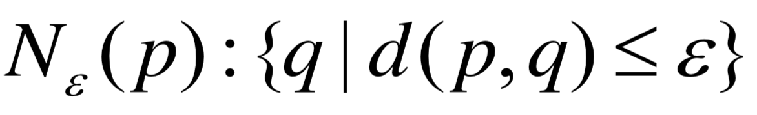
ε-Neighborhood
ε-Neighborhood – Objects within a radius of ε from an object.
“High density” - ε-Neighborhood of an object contains at least MinPts of objects.
ε-Neighborhood of p
ε
ε
ε-Neighborhood of q
q
p
Density of p is “high” (MinPts = 4)
Density of q is “low” (MinPts = 3)

Slide 44
Core, Border & Outlier
Outlier
Given ε and MinPts, categorize the objects into three exclusive groups.
Border
A point is a core point if it has more than a specified number of points (MinPts) within Eps. These are points that are at the interior of a cluster.
A border point has fewer than MinPts within Eps, but is in the neighborhood of a core point.
A noise point is any point that is not a core point nor a border point.
Core
ε = 1unit, MinPts = 5

Slide 45
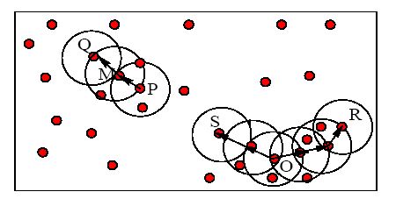
Example
M, P, O, and R are core objects since each is in an Eps neighborhood containing at least 3 points
Minpts = 3
Eps = radius of the circles

Slide 46
Density-reachability
Density-Reachable (directly and indirectly):
A point p is directly density-reachable from p2;
p2 is directly density-reachable from p1;
p1 is directly density-reachable from q;
p←p2←p1←q form a chain.
p is (indirectly) density-reachable from q
q is not density- reachable from p?
p
p₂
p₁
A point q is directly reachable from p if point q is within distance ε from core point p. Points are only said to be directly reachable from core points.
q
MinPts = 7

Slide 47
Density-Connectivity
Density-reachable is not symmetric
not good enough to describe clusters
Density-Connected
A pair of points p and q are density-connected if they are commonly density-reachable from a point o.
Density-connectivity is symmetric
p
q
o

Slide 48
Review of Concepts
Is an object o in a cluster or an outlier?
Are objects p and q in the same cluster?
Are p and q density-connected?
Is o a core object?
Is o density-reachable by some core object?
Are p and q density-reachable by some object o?
Directly density-reachable
Indirectly density-reachable through a chain

Slide 49
DBSCAN Algorithm
Input: The data set D
Parameter: ε, MinPts
For each object p in D
if p is a core object and not processed then
C = retrieve all objects density-reachable from p
mark all objects in C as processed
report C as a cluster
else mark p as outlier
end if
End For
DBSCAN Algorithm

Slide 50
DBSCAN Algorithm: Example
Parameter
ε = 2 cm
MinPts = 3
for each o ∈ D do if o is not yet classified then if o is a core-object then collect all objects density-reachable from o and assign them to a new cluster. else assign o to NOISE

Slide 51
DBSCAN Algorithm: Example
Parameter
ε = 2 cm
MinPts = 3
for each o ∈ D do if o is not yet classified then if o is a core-object then collect all objects density-reachable from o and assign them to a new cluster. else assign o to NOISE

Slide 52
DBSCAN Algorithm: Example
Parameter
ε = 2 cm
MinPts = 3
for each o ∈ D do if o is not yet classified then if o is a core-object then collect all objects density-reachable from o and assign them to a new cluster. else assign o to NOISE

Slide 53
MinPts = 5
ε
P₁
ε
ε
C₁
P
P
C₁
C₁
1. Check the ε-neighborhood of p;
2. If p has less than MinPts neighbors then mark p as outlier and continue with the next object
3. Otherwise mark p as processed and put all the neighbors in cluster C
1. Check the unprocessed objects in C
2. If no core object, return C
3. Otherwise, randomly pick up one core object p₁, mark p₁ as processed, and put all unprocessed neighbors of p₁ in cluster C

Slide 54
ε
ε
C₁
C₁
ε
ε
ε
C₁
C₁
C₁

Slide 55
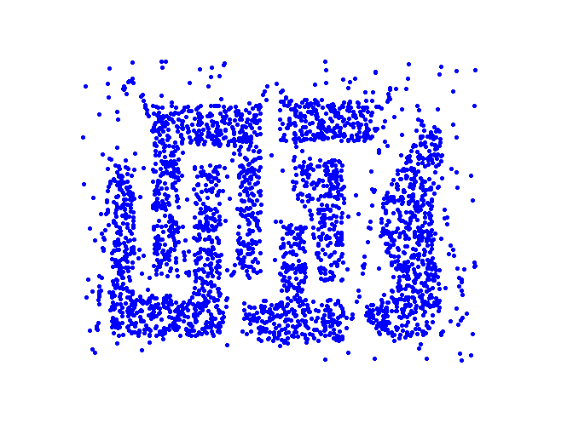
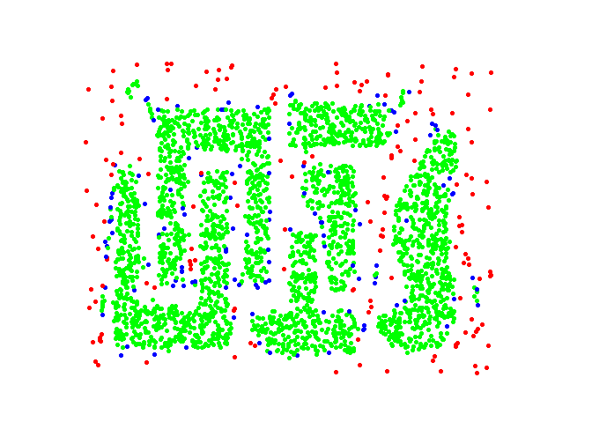
Example
Original Points
Point types: core, border and outliers
ε = 10, MinPts = 4

Slide 56
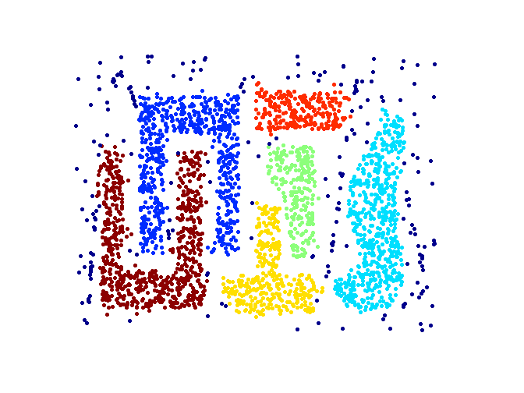
When DBSCAN Works Well
Original Points
Clusters
Resistant to Noise
Can handle clusters of different shapes and sizes

Slide 57
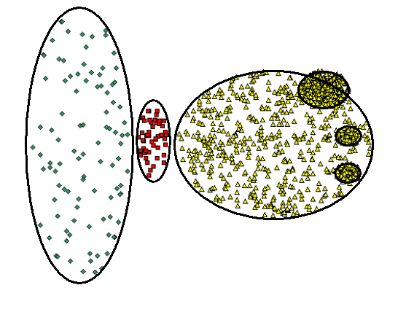


When DBSCAN Does NOT Work Well
(MinPts=4, Eps=9.92).
Original Points
Cannot handle Varying densities
sensitive to parameters
(MinPts=4, Eps=9.75)

Slide 58



DBSCAN: Sensitive to Parameters

Slide 59
Determining the Parameters ε and MinPts
Cluster: Point density higher than specified by ε and MinPts
Idea: use the point density of the least dense cluster in the data set as parameters – but how to determine this?
Heuristic: look at the distances to the k-nearest neighbors
Function k-distance(p): distance from p to the its k-nearest neighbor
k-distance plot: k-distances of all objects, sorted in decreasing order
p
3-distance(p) :
q
3-distance(q) :

Slide 60

Determining the Parameters ε and MinPts
Example k-distance plot
Heuristic method:
Fix a value for MinPts (default: 2 × d –1)
User selects “border object” o from the MinPts-distance plot; ε is set to MinPts-distance(o)
3-distance
first „valley“
Objects
„border object“

Slide 61

Determining the Parameters ε and MinPts
Problematic example
A
C
F
E
A, B, C
B, D, E
G
3-Distance
B‘, D‘, F, G
G1
G3
D1, D2,
G1, G2, G3
B
D
G2
D’
B’
D1
Objects
D2

Slide 62
Density Based Clustering: Discussion
Advantages
Clusters can have arbitrary shape and size
Number of clusters is determined automatically
Can separate clusters from surrounding noise
Can be supported by spatial index structures
Disadvantages
Input parameters may be difficult to determine
In some situations very sensitive to input parameter setting

Slide 63
OPTICS: Ordering Points To Identify the Clustering Structure
DBSCAN
Input parameter – hard to determine.
Algorithm very sensitive to input parameters.
OPTICS – Ankerst, Breunig, Kriegel, and Sander (SIGMOD’99)
Based on DBSCAN.
Does not produce clusters explicitly.
Rather generate an ordering of data objects representing density-based clustering structure.

Slide 64
OPTICS con’t
Produces a special order of the database wrt its density-based clustering structure
This cluster-ordering contains info equiv to the density-based clusterings corresponding to a broad range of parameter settings
Good for both automatic and interactive cluster analysis, including finding intrinsic clustering structure
Can be represented graphically or using visualization techniques

Slide 65
Density-Based Hierarchical Clustering
Observation: Dense clusters are completely contained by less dense clusters
Idea: Process objects in the “right” order and keep track of point density in their neighborhood
C
D
C
1
C
2

Slide 66
Core- and Reachability Distance
Parameters: “generating” distance ε, fixed value MinPts
core-distance_{ε,MinPts}(o)
“smallest distance such that o is a core object” (if that distance is ≤ ε ; “?” otherwise)
reachability-distance_{ε,MinPts}(p, o)
“smallest distance such that p is
directly density-reachable from o” (if that distance is ≤ ε ; “?” otherwise)
MinPts = 5
p
o
ε
q
core-distance(o)
reachability-distance(p,o)
reachability-distance(q,o)

Slide 67
OPTICS: Extension of DBSCAN
Order points by shortest reachability distance to guarantee that clusters w.r.t. higher density are finished first. (for a constant MinPts, higher
density requires lower ε)

Slide 68

The Algorithm OPTICS
Basic data structure: controlList
Memorize shortest reachability distances seen so far (“distance of a jump to that point”)
Visit each point
Make always a shortest jump
Output:
order of points
core-distance of points
reachability-distance of points

Slide 69
The Algorithm OPTICS
ControlList ordered by reachability-distance.
ControlList
cluster-ordered file
≥
foreach o ∈ Database // initially, o.processed = false for all objects o if o.processed = false; insert (o, “?”) into ControlList; while ControlList is not empty select first element (o, r-dist) from ControlList; retrieve N_{ε}(o) and determine c_dist= core-distance(o); set o.processed = true; write (o, r_dist, c_dist) to file; if o is a core object at any distance ≤ ε foreach p ∈ N_{ε}(o) not yet processed; determine r_dist_{p} = reachability-distance(p, o); if (p, _) ∉ ControlList insert (p, r_dist_{p}) in ControlList; else if (p, old_r_dist) ∈ ControlList and r_dist_{p} < old_r_dist update (p, r_dist_{p}) in ControlList;
database

Slide 70


OPTICS: Properties
“Flat” density-based clusters wrt. ε* ≤ ε and MinPts afterwards:
Starts with an object o where c-dist(o) ≤ ε* and r-dist(o) > ε*
Continues while r-dist ≤ ε*
Performance: approx. runtime( DBSCAN(ε, MinPts) )
O( n * runtime(ε-neighborhood-query) )
without spatial index support (worst case): O( n² )
e.g. tree-based spatial index support: O( n ∗ log(n) )
1
2
17
3
16
18
3
1
4
4
2
16
17
18
Core-distance
Reachability-distance

Slide 71


OPTICS: The Reachability Plot
represents the density-based clustering structure
easy to analyze
independent of the dimension of the data
reachability distance
reachability distance
cluster ordering
cluster ordering

Slide 72
OPTICS: Parameter Sensitivity
Relatively insensitive to parameter settings
Good result if parameters are just “large enough”
1
3
2
MinPts = 10, ε = 10
MinPts = 10, ε = 5
MinPts = 2, ε = 10
1
2
3
1
2
3
1
2
3

Slide 73
An Example of OPTICS
neighboring objects stay close to each other in a linear
sequence.
Reachability-distance
undefined
‘
Cluster-order of the objects

Slide 74
DBSCAN VS OPTICS
 | DBSCAN | OPTICS
Density | Boolean value (high/low) | Numerical value (core distance)
Density-connected | Boolean value (yes/no) | Numerical value (reachability distance)
Searching strategy | random | greedy

Slide 75

When OPTICS Works Well
Cluster-order of the objects

Slide 76

When OPTICS Does NOT Work Well
Cluster-order of the objects

Slide 77
Outline
Cluster Basics
Clustering algorithms
Hierarchical clustering, spectral clustering
k-means, Expectation-Maximization (EM)
DBSCAN
state-of-art algorithms
Cluster Validity
determining the number of clusters
clustering evaluation
Notes:
77

Slide 78

Exemplar-Based Methods
Cluster data by identifying representative exemplars
An exemplar is an actual dataset point, similar to a medoid
All data points are considered as possible exemplars
The number of clusters
is decided during learning
(but a depends on a
user-defined parameter)
Methods
Convex Mixture Models
Affinity Propagation

Slide 79
Affinity Propagation (AP) (Frey et al., Science 2007)
Clusters data by identifying representative exemplars
Exemplars are identified by transmitting messages between data points
Input to the algorithm
A similarity matrix where s(i,k) indicates how well data point x_{k} is suited to be an exemplar for data point x_{i}.
Self-similarities s(k,k) that control the number of identified clusters and a higher value means that x_{k} is more likely to become an exemplar
Self-similarities are independent of the other similarities
Higher values result in more clusters

Slide 80


Affinity Propagation
Clustering criterion:
s(i,c_{i}) is the similarity between the data point x_{i} and its exemplar
Minimized by passing messages between data points, called responsibilities and availabilities
Responsibility r(i,k):
Sent from x_{i} to candidate exemplar x_{k} reflects the accumulated evidence for how well suited x_{k} is to serve as the exemplar of x_{i} taking into account other potential exemplars for x_{i}

Slide 81


Affinity Propagation
Availability a(i,k)
Sent from candidate exemplar x_{k} to x_{i} reflects the accumulated evidence for how appropriate it would be for x_{i} to choose x_{k} as its exemplar, taking into account the support from other points that x_{k} should be an exemplar
The algorithm alternates between responsibility and availability calculation and
The exemplars are the points with r(k,k)+a(k,k)>0
https://www.psi.toronto.edu/affinitypropagation/webapp/

Slide 82

Affinity Propagation

Slide 83



Results
https://www.psi.toronto.edu/affinitypropagation/webapp/

Slide 84
Clustering by fast search and find of density peaks (Alex Rodriguez et al., Science 2014)
Two leading criteria
Local density
Minimum distance with higher density
We can choose dc so that the average number of neighbors is around 1to 2% of the total number of points in the data set

Slide 85
Clustering by fast search and find of density peaks (Alex Rodriguez et al., Science 2014)

Slide 86


Results
Pictorial representation of the cluster assignations for the first 100 images. Faces with the same color belong to the same cluster, whereas gray images are not assigned to any cluster. Cluster centers are labeled with white circles.

